Slide 1
Formula Kite European Championships
Running a sustainable event

Slide 2
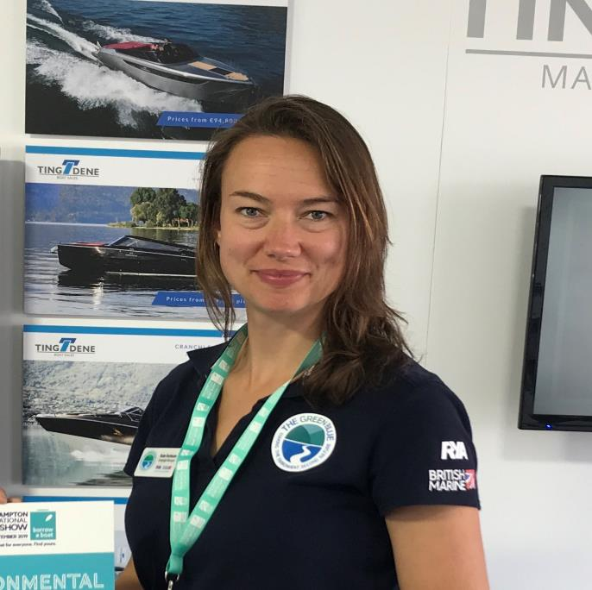
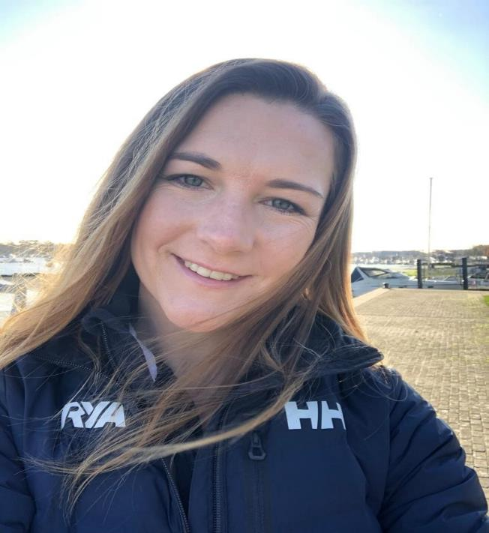
Presented by:
Kate Fortnam
Campaigns Manager
RYA - The Green Blue
Susie Moore
Regional Development Officer
RYA – South Region
Notes:
KATE
Thank you for joining us. We are going to run through our approach to running a sustainable event using the Formula Kite Championship as a case study.
talking to you today is Susie – RYA Regional Manager and Kate The Green Blue Manager.
We are hoping to save some time for questions and discussion at the end of the presentation.

Slide 3
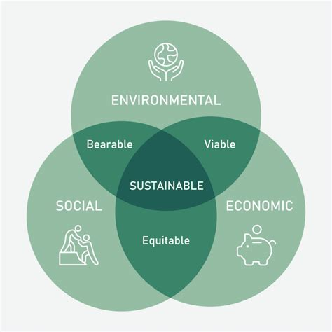
What makes a sustainable event?
Notes:
Kate
Sustainability is such a broad concept and every organisation has a different approach. Many currently associate 'sustainability' with environment, but it encompasses these three main areas.
For us, we believe sustainability to be in the more traditional sense with managing the social, economic and environmental factors in a balancing act. With the focus on all but in this presentation we are focusing predominantly on the social and evironmental aspects of the event– finding opportunities to enhance and minimise any negative impacts.
Socially – it is about inclusivity, health, education and respect, community.
Environmental – minimising impacts on water, land, air and nature (Wildlife & Habitats)
Economic – Supporting local economy – Using local suppliers to provide food vendors, bringing in visitors to the Portsmouth Area who will be using public travel and accommodation as well as local shops, water sports centre (Andrew Simpson Foundation).

Slide 4
Contents
What do we mean by a sustainable event?
The Formula Kite event
Clean Regattas
Operations and Facilities
Community Engagement
    Pre, During, Post
    Education
    Communications
Keys to success
Resources
Question & Discussion

Slide 5
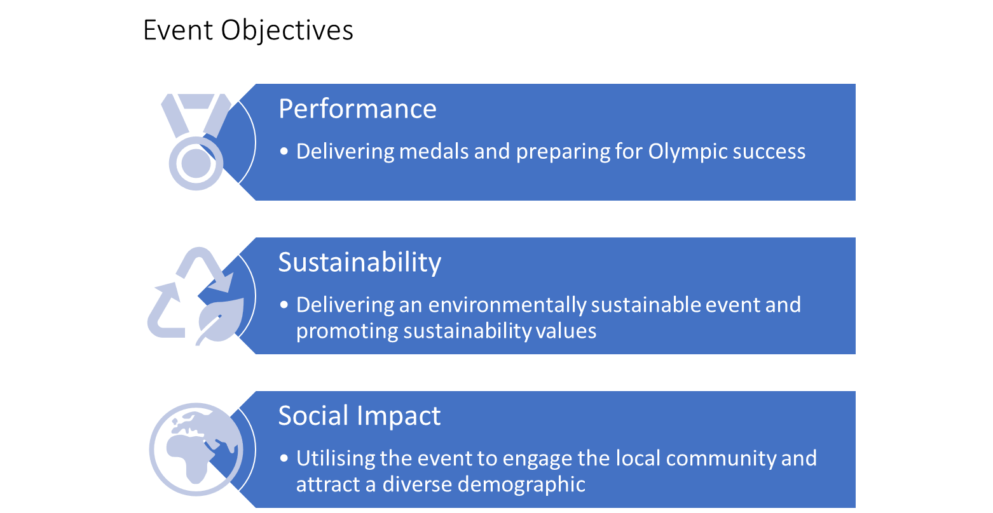
Notes:
Susie
In the bid for the event – the RYA set out an agreed Vision, Mission and Values for the event. These were at the core of the event planning and delivery.
They are why UK Sport, RYA and Portsmouth City Council agreed to provide funding for the event.
The event objectives were:
Performance, Sustainability and Social Impact.

Slide 6
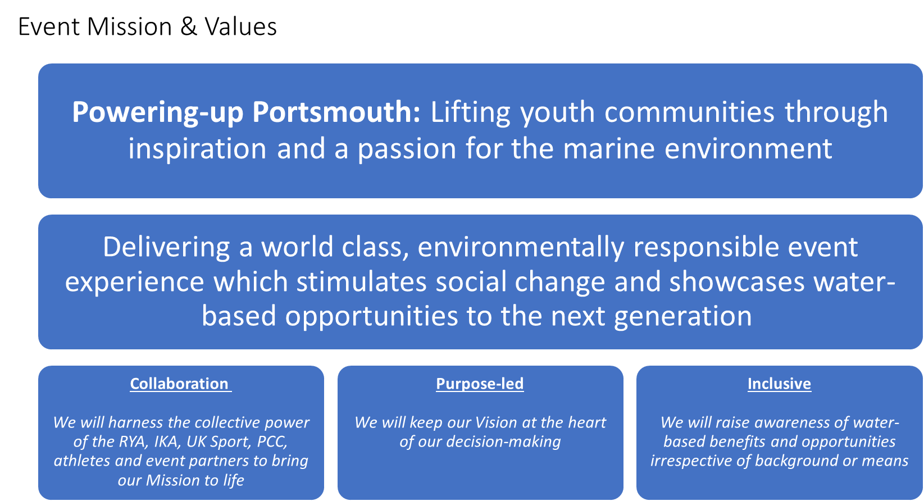
Notes:
Susie
The mission was Powering-up Portsmouth: Lifting the youth communities through inspiration and a passion for the marine environment.
The event values were collaboration, purpose-led and inclusive.

Slide 7
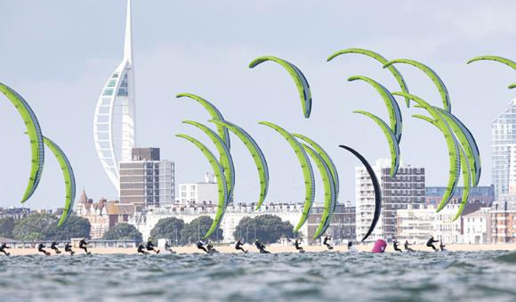
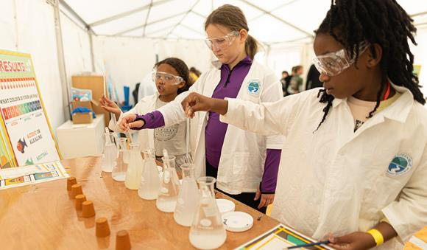
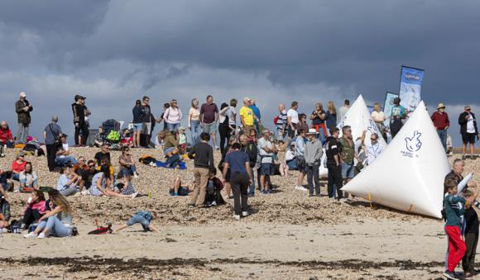

Formula Kite European Championship
Eastney Beach, Portsmouth
112 riders from 28 nations competed
An Olympic qualifying event
Educational Resources - potential audience of 2,400 children
Beach Club - 339 children taking part
Created a Fan Zone for the finals weekend, encouraging spectators to attend for free
50 volunteers, 25% local
The event was run in partnership
Clean Regattas
Notes:
Susie
The Formula Kite European Championship was held on Eastney Beach Portsmouth, the event site being on the beach with no facilities in place already.
We had 112 riders from 28 nations competed.
It was an Olympic qualifying event.
We created a Fan Zone for the finals weekend, encouraging spectators to attend for free. To watch the racing and interact with the event village including trying water sports opportunities.
The event was run in partnership. Led by the RYA supported by Portsmouth City Council, The National Lottery, and the International Kiteboarding Association. The official event partner was Gunwharf Quays.
The event focused on promoting environmental responsibility as well as inspiring local communities around the marine environment and water-based opportunities.

Slide 8

Clean Regattas
Formula Kite European Championship has achieved the Platinum certification for Clean Regattas by Sailors for the Sea.
To achieve Platinum, 20 sustainable best practices need to be achieved. This provided a framework for our sustainability actions.
This includes…
Elimination of single use items.
Involving local organizations.
Raising awareness and educating.
Organizing a Green Team.
Implementing Green Boating Practices
cleanregattas.sailorsforthesea.org
Notes:
KATE
Early in the planning stages, the event local organising committee agreed to register and aim for the Platinum Clean Regattas Award. This provided a framework for the sustainability actions. To achieve Platinum, 20 sustainable best practices need to be achieved as well as a post event report evidencing the actions.
Clean Regattas is the sustainable certification for any water-based events, and over 3600 events have been certified. They provide a toolkit with resources and examples on how to achieve the 20 best practice actions.
This includes…
Elimination of single use items.
Involving local organizations.
Raising awareness and educating.
Organizing a Green Team.
Implementing Green Boating Practices
You can find more information on the website.

Slide 9
Operation & Facilities
Notes:
KATE
I am going to start by looking at the actions related to the operations and facilities of the event.

Slide 10
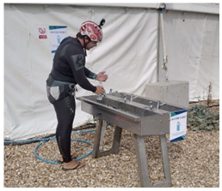
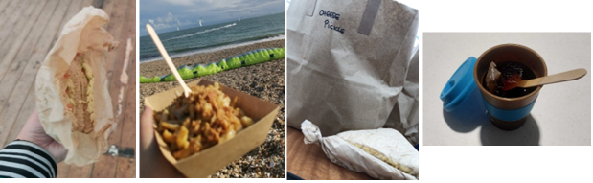
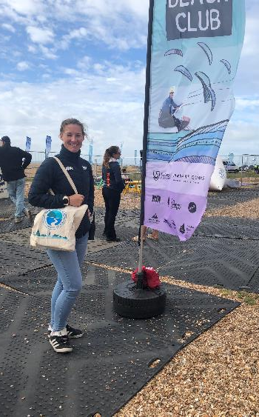
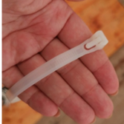
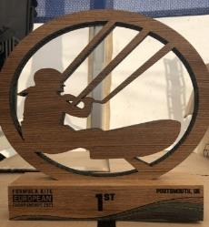
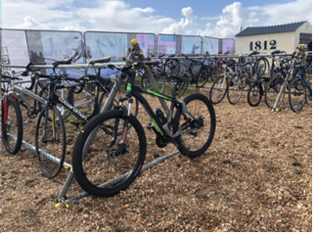
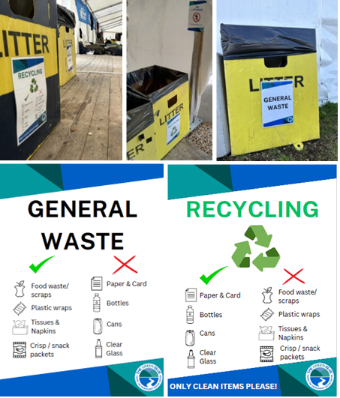
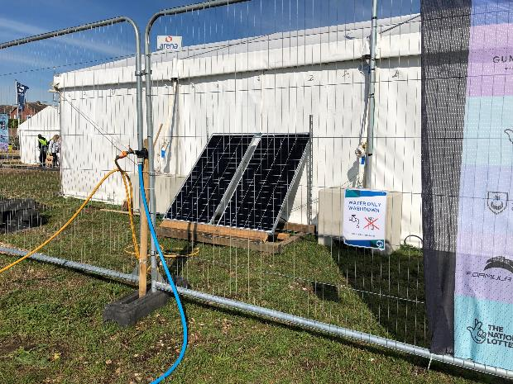
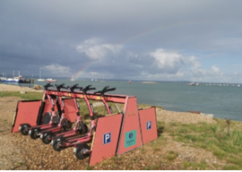
Operations and Facilities
Creating a Green Team
Waste
Procurement
Water Use
Energy Use
Travel
Notes:
KATE
Working towards clean regattas provided a good framework of all the key areas to work on. A major part of the events success was due to the Sustainability team being part of the event local organising community. Therefore, from the start we were involved with the decisions and working with the wider event team to embed sustainability.
So much work went on behind the scenes within the planning stages such as within communications to vendors and sponsors which outlined our sustainability goals and requested for example no single use packaging to be used and the offering of vegan / vegetarian food. Within all the research, conversations and then contracts for key suppliers such as the marquees, toilets, waste management company, water supply and energy. Looking at what is most suitable option from an environmental perspective and ensuring we engaged and prioritised working with local companies wherever possible.
***One of the first actions the team carried out was creating an Environment risk assessment – to set out what the environmental impacts are and develop suitable actions to mitigate.
Other key areas focused on were:
Creating a Green Team – Having RYA Staff, Volunteers and Athletes working closely with the Event Team to identify where Clean regattas Criteria could be met and other aspects of the event that could be made more sustainable beyond this. Also to ensure we had people ensuring operations and facilities were being actioned during and after the event each day and to run environmental education sessions.
Waste
- Reducing single use plastic across the event, ensuring there were recycling bins that were suitably labelled – used local council waste providers to supply these.
- We also used re-usable cable ties.
- Encouraged staff and athletes to bring their own reusable drinks bottles.
- Provided reusable coffee cups to use at vendors.
- Reusable tote bags provided where required
- Food for staff and volunteers proved locally and used recycle paper packaging to avoid plastics
- No sponsorship or advertising stickers on the athlete’s boards.
Procurement – everything purchased for the event had considered the sustainability impact.
Used local suppliers and vendors where possible with sustainability standards – sourcing food produce locally as well.
Re-using as many event items as possible:
- Signage at the event was not dates and event specific so could be reused at other RYA events. Any signage specific to the event to be returned to manufacturers for textile recycling.
- The trophies were made of FSC wood.
Water Use– ensuring water refill points were available using water mains supply through working with local council, signposted refill taps, and encouraging everyone to bring their own bottles through communications to visitors and athletes.
Energy
- Purchased a small solar panel set up which powered the race office for the event (£1500), and will be re-used on the RYA event trailer at other events.
- We also needed a generator – we used HVO fuel, which is a biofuel. All vendors on site were also able to connect to this main generator, drastically reducing the associated emissions.
Travel
- Promoting green travel options and Providing cycle storage on-site.
- Working with the local electric scooter company to provided additional scooters close to the event site.
- Facilitating car sharing using own RYA plug in hybrid vehicles where possible for staff.

Slide 11
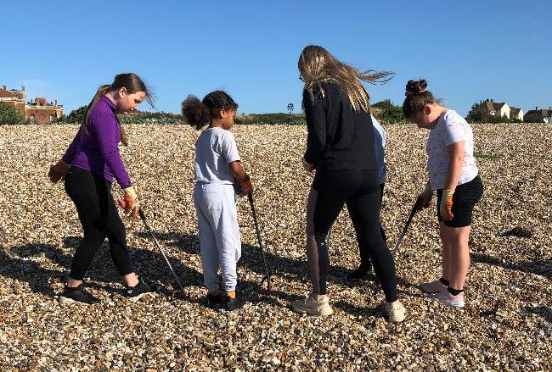
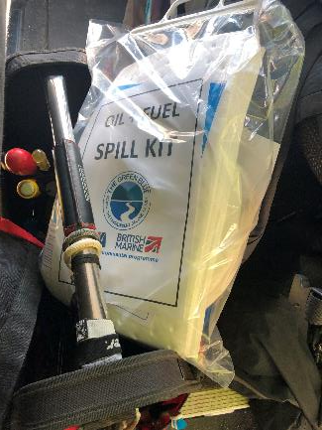
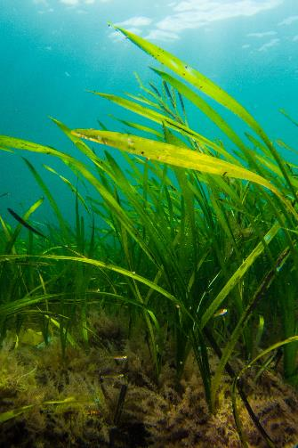
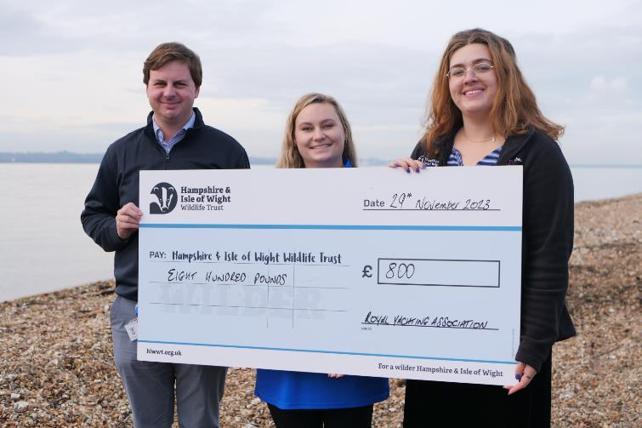
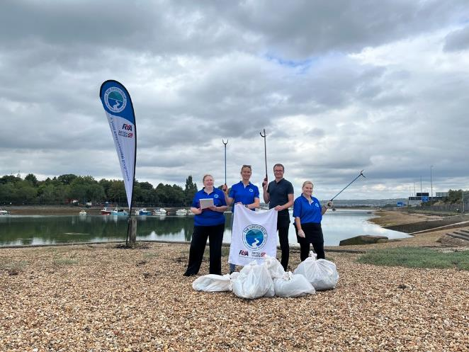
Operations and Facilities
Habitats + Wildlife
Water Quality - Testing
Beach Cleans
Communications
Notes:
KATE
Continued Facilities & Operations:
Habitat and wildlife as another key impact for us – in a designated Local Wildlife Site (LWS) as the beach is home to a large amount of vegetated shingle.
Created a procedure and sought external advice from government body and conservation organisations (Marine Conservation Society and Natural England). Identifying what wildlife is present in the area and potential risk of wildlife entering the race area.
Promoted the check clean dry biosecurity protocol amongst staff, volunteers and athletes to reduce any risks from the spread of invasive species in written and verbal communications.
Donated £800 to Hampshire and Isle of Wight Wildlife Trust Solent Seagrass Restoration Project. They are restoring seagrass in a site adjacent to the event site. The value was from our own ‘environment tax’ which was added to each litre of fuel used in the event boats.
Water testing – due to the location of the event near two sewage discharge points, we wanted to ensure we protected the participants from any risks of contaminated water.
- Again, we sought expert advise on how to respond to contaminated water, including World Sailing, World Triathlon to learn about their challenges and how we could implement solutions into our own procedures.
- Created a procedure and carried out our own testing using a local laboratory. However lab results developed 2
- We ensured that we used multiple methods to monitor the discharges and pollutions so not relying solely on testing e.g. Surfers Against Sewage – sewage discharge alerts.
- Created a water quality risk assessment and a background paper which was shared with the wider event team.
Beach cleans – carried out multiple beach cleans as part of the event – staff, volunteers, athletes and council and as part of the environmental education sessions ran with local schools. A total of 123kg of waste was collected with 92 people taking part.
Communications – ensured that we communicated across multiple challenges our goals and the actions implemented. This included a sustainability section on the event website, signage across the event site, articles on the event included sustainability and in communications sent out to the volunteers and athletes.

Slide 12
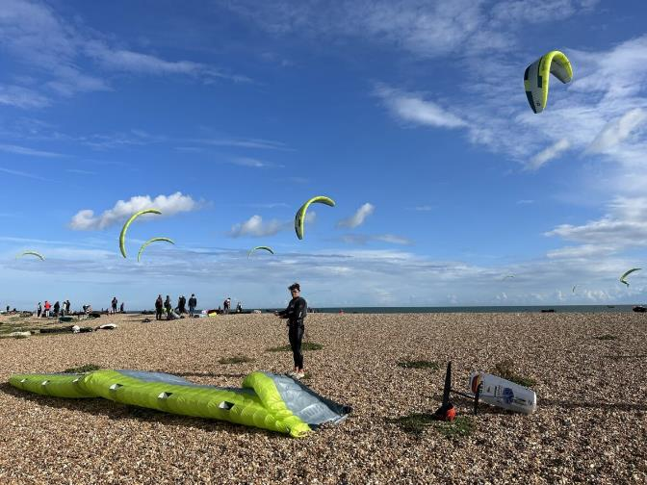
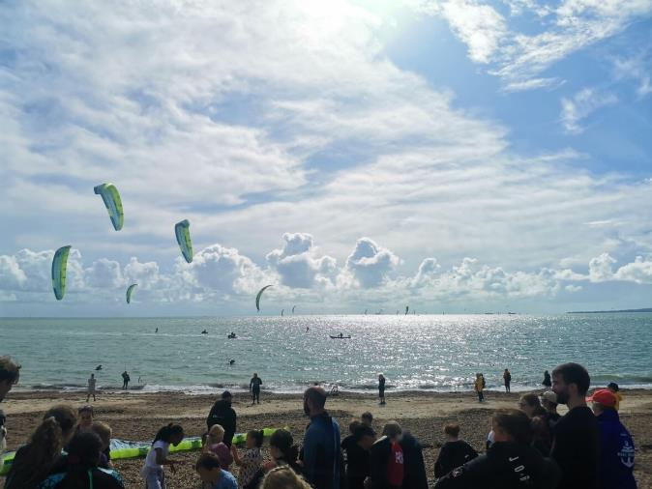
Operations and Facilities – Challenges
Location
Cost
Time
Water testing
Data Collection
Notes:
KATE
The challenges experienced are probably what would be expected.
Location – being on the beach, there was a risk of pollution from multiple sources impacting the environment directly. For example, wash down facilities for equipment, and shower facilities It was planned to connect to a local community building which provided showers, thus none on the beach. And it was insisted that all wash down was water only. This was a challenge to implement, I didn’t see any products being used on the beach, however in the storage and preparation area there were a few cleaning products being used. Also ensured that there were plenty of spill kits available.
Cost – limited budget for sustainability initiatives. Added unexpected costs due to the beach side locations and extra spending on the facilities required. Cost of having the HVO fuel and solar set up. Having access to water was expensive and complicated. As well as insisting the waste contractors collected and separated to waste streams, which initially they were not keen on doing.
Time - It was intense event period being on-site – water testing, running the beach club, supporting the volunteers and event team. Vital to have the support of Green Team to help implement.
We also had another 10 day event – The Southampton Boat Show that the RYA Sustainability Team was part of organising The Green Blue, RYA stand and talks at the event. Staff split between – requiring more volunteer support.
Water testing – 3 days for results , so rather limited on how to react at that point. Multi-sources used to assess the water quality including getting alerts via the Surfers Against Sewage Safer Seas and rivers app.
Collecting data – travel information forms to record carbon and gather learnings. Despite asking and being sent out very few completed by Athletes as forms passed from RYA to IKA to then pass to athletes. Therefore would collect the data on-site during the event or at registration.
We were fortunate that initial support was there, and sustainability was set out within the original objectives, without it would be very tricky.

Slide 13
Community Engagement
Notes:
SUSIE

Slide 14
Pre, During or Post?
Pre event
During event
Post event
Volunteering Opportunities
Communication
Legacy
Engaging Youth Communities
Comms
Communication
Spectators
Legacy
Notes:
Within the area of Community Engagement we identified 3 opportunities to engage the local community.
Volunteering, Engaging Youth, Spectators
Community Engagement doesn’t have to be Legacy. We made a conscious decision to focus on Pre and During the event utilizing the fixed dates of the Championship to create a focal point and launch pad for ongoing activity which pulled on the outcomes and connections made creating a legacy

Slide 15
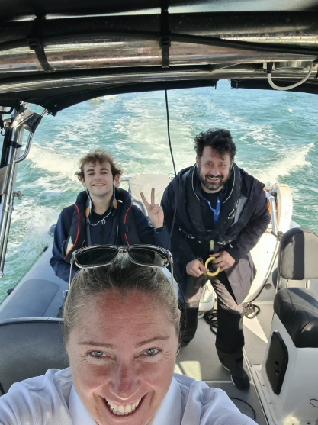
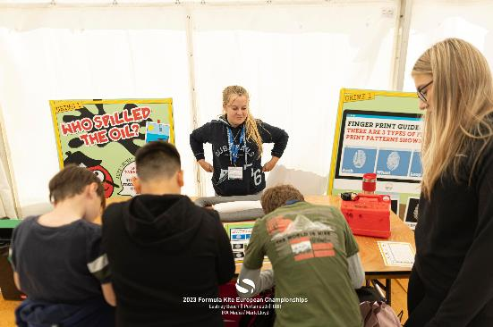
Utilising Volunteers
50 volunteers across the event – 50% were local
Why?
Reduced cost and increased capacity
Increased experience and skill within network
More opportunity than we took advantage of
Notes:
Volunteers
50 volunteers from outside of the partner delivery organisations carried out core roles - 50% were locally based. These were sourced through general volunteer networks locally accessibly through our partnership with Portsmouth City Council as well as through our local connections in the boating network. By including local volunteers in the delivery we reduced the number of staff required and so costs associated with the running of the event. It also helps to reduce travel related emissions. While we were able to increase the experience and skills of those involved. In turn rising the standards within the local network.
This is an area where honestly we could have done a lot more and had identified other opportunities, such as enabling skill development pre-event and opening up the opportunity to those from outside the network. However we all face resource limitations.

Slide 16
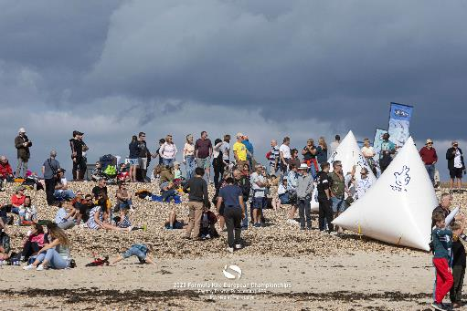
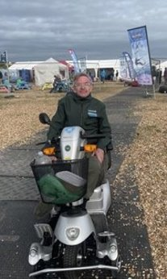
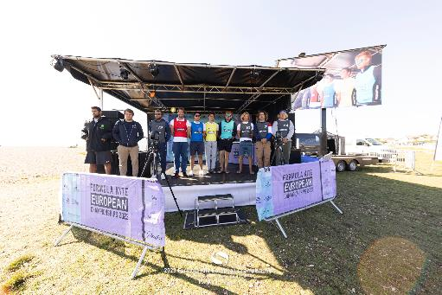
Spectators
1000 people visiting the Fan Zone
Big screen and Stage
Commentary
Information stands
Taster Sessions
Kids Activities
Why?
Awareness and Connection
Notes:
Meet David – accessibility – access to the sport

Slide 17
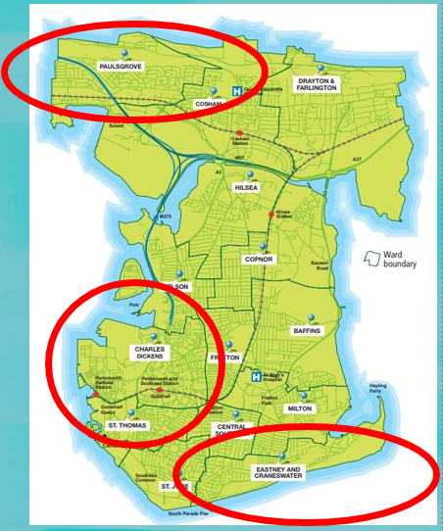
Engaging Youth Communities
Our main focus within Community Engagement​
​
Spark a positive connection with the water and influencing future behaviour​
​
Aim - 200 youth people​
Targeting those facing barriers to participating in water-based activities​ such as...
disabilities,​
diverse communities,​
within low-income families​
​
Ages 8 - 14
Notes:
The event aimed to engage with 200 young people during the Championship period, specifically targeting individuals facing barriers to participating in water-based activities, such as those with disabilities, from diverse communities, or within low-income families.
Three focus wards were selected by Portsmouth City Council, but a whole-city approach was taken.
•Paulsgrove, due to geographical positioning and limited connection to the water;
•Charles Dickens, as they are within the highest level of deprivation in the city, and the largest source of youth anti-social behaviour;
•Eastney & Craneswater, as the local area to the event venue and being less connected to the rest of Portsmouth due to limited transport links.
With a focus on influencing future behaviour and starting a positive connection with the water, the target audience was narrowed to the age range of school years 4 – 9, ages 8 – 14.
Meeting the British Sailing Team athletes – inspiring

Slide 18

Connected Initiatives
Pre event
During event
Post event
Awareness
Connection
Trial
Opportunity
Regular
Educational Resources
Beach Club / Taster Sessions/ Meet Role Models
Learn to/ recognised certification
Regular participation opportunities within network
Marine relevant qualifications/ Internships

Slide 19
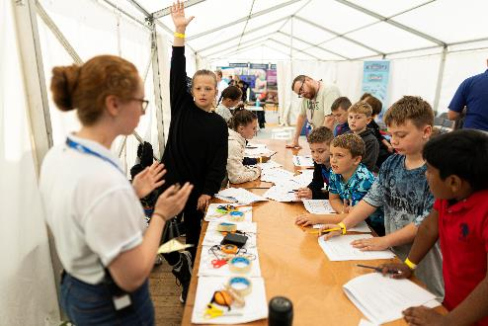
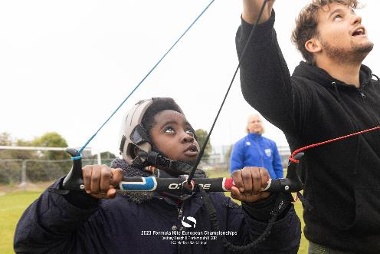
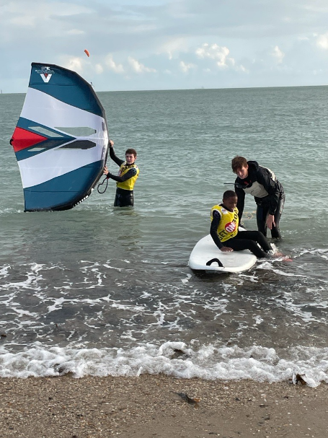
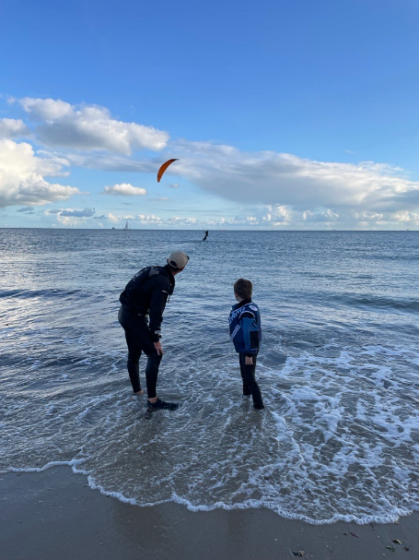
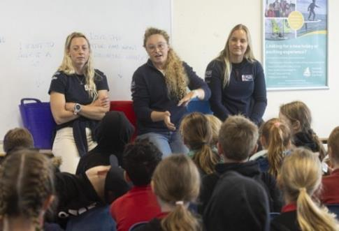
Engaging Youth Communities
Teachers Resources - potential audience 2,400
Beach Club - 339 participants taking part in 1,170 sessions
11% increase in positive feelings towards the water.
Notes:
Meeting the British Sailing Team athletes – inspiring

Slide 20

Working in Partnership

Slide 21
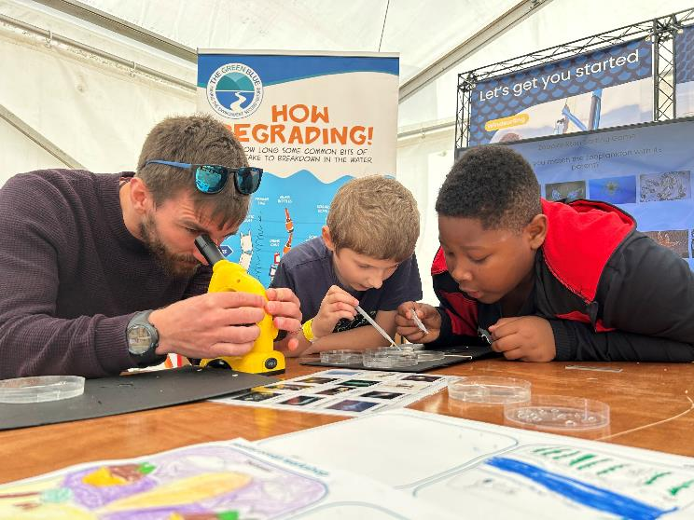



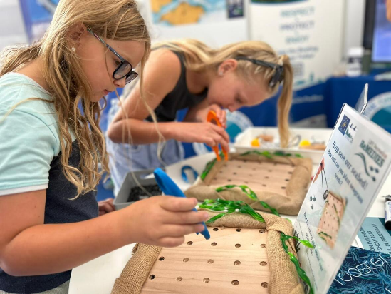
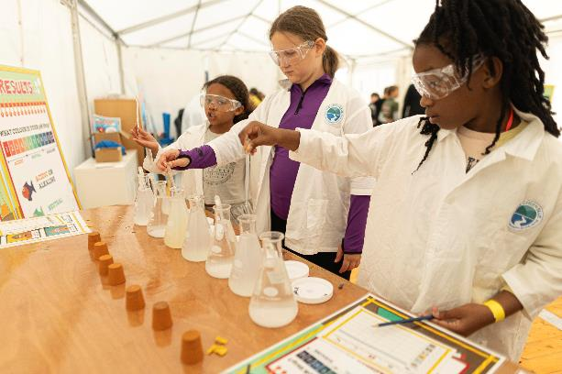
Environmental Sessions
&
Beach Clean and litter survey
Marine CSI Activity – Litter, invasive species, water quality
Biodiversity: Seagrass habitats and phytoplankton
Notes:
KATE
The Green Blue partnered with the Marine Conservation Trust to deliver environmental awareness sessions with school and youth groups.
Already working in partnership with MCS through a Seagrass Project here in England called ReMEDIES to deliver sessions on seagrass and how the community can help protect it.
Citizen Science: MCS was also a good fit as the beach clean data could contribute towards their National Beach Clean litter survey work.

Slide 22


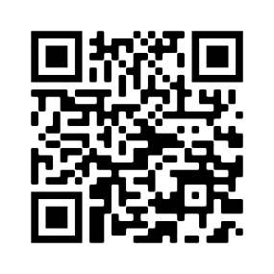
thegreenblue.org.uk/boating-pledge
Notes:
KATE
Encouraging visitors to adopt environmental best practice beyond the event when boating by making The Green Blue Boating Pledge
A pledge to follow key environmental bets practice to Respect, Protect and Enjoy our boating environment.

Slide 23
Communications
What we Communicated
Actions that we had put in place
Event objectives and missions
Behavioural change actions needed
Informative
Raising awareness of wider issues
Methods of Communication
Signage at the event
A video on display in the fan zone
Social Media
Direct communications over email to all involved
Articles and publications (local newspaper, magazine, website)
Event Website
Notes:
KATE
What we communicated:
Actions that we had put in place, promoting the sustainability efforts. Such as using renewable energy sources, engaging with local companies and the social impact project.
The event objective and mission
Behavioural change actions – asking athletes and volunteers to bring reusable bottles, consider how they travel. Complete a travel form, arrive with clean equipment, water only washdowns.
Informative – waste bin signs, water refill points, sharing of the documentation such as environmental risk assessment.
Raising awareness of wider issues – check clean dry and invasive species, seagrass restoration and the remedies project, boating best practice, The Green Blue and the boating pledge.
How we communicated:
Signage at the event – posters and banners
A video display in the fan zone area
Social media
Direct communications over email to volunteers, coaches, athletes
Written Articles- RYA Website, RYA magazine and a local newspaper
Event Website: A webpage on the event website dedicated to sustainability

Slide 24
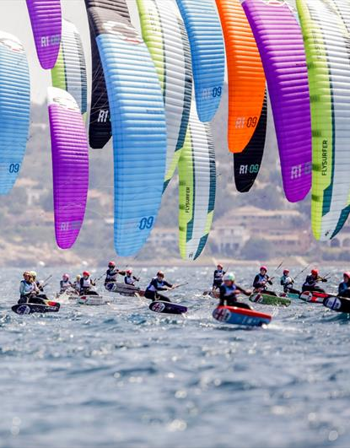
Keys to success
Be involved in the planning stages – Sustainability at the heart
Scope opportunities, insights and what is already happening in the space.
Partner - don’t do it all yourself and co-create
Focus on the event's greatest impacts and work within your limitations
Implement visible actions, no matter how small, they do make a difference.
Use the event to raise awareness
Notes:
SUSIE
Establish clarity and agreement of aims and objectives.
Scope opportunities, insights and what is already happening in the space
Being involved as much as possible in the planning stages of the event ensures sustainability is embedded throughout.
Narrow down – the opportunity is huge. Focus on the events greatest impacts and develop suitable actions to match.
Make use of partners – don’t do it all yourself. Create a Green team – have someone responsible to led on the environmental work. Some images of our green team in action.
Co-create with your target audience.
Use the event to raise awareness of wider environmental issues – using the event as a platform to educate – kate will discuss this further later
Implement the visible actions – no matter how small they do make a difference. This may include having signage, making sure recycling is in place and providing water refill points.
Work within your limitations.

Slide 25
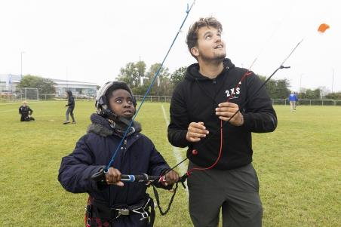
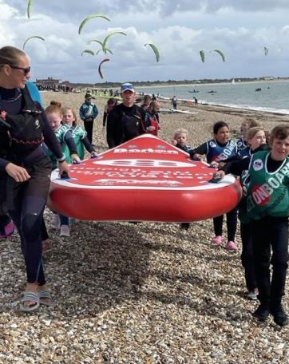
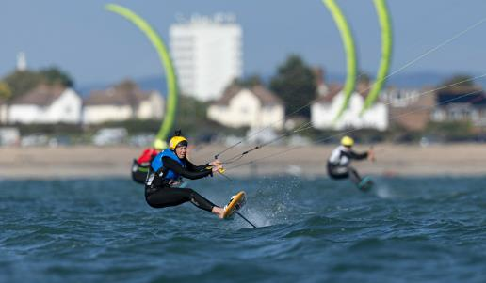
Conclusion
The event achieved its objectives initially set out.
Social impact and sustainability were at the heart of this event.
Awarded Platinum Clean Regattas for Sailors for the Sea.
Sustainability being at the forefront of event delivery and planning allowed for adoption and implementation throughout the event operations.
We learnt a lot, including implementing new actions to take forward to future events and those which are more challenging than expected.
Notes:
Susie

Slide 26

Resources
Social Impact Report for the Formula Kite European Championships.
The Green Blue – Sustainable Event Toolkit and Sustainable Event Checklist
Clean Regattas website by Sailors for the Sea
World Sailing
Contact Us
environment@rya.org.uk
Notes:
Kate
There are lots of resources and information available to support running a sustainable event.
For more information on this event, please get in touch if you would like a copy of the social impact report – this will soon be available on the RYA website and on the Clean Regattas website.
Green Blue website: Resources and information on sustainable events for clubs and associations. Including a detailed event toolkit and a sustainable event checklist.
Clean Regattas website: Giving information around the best practice areas as well as past case studies and event reports.
For more information and to get a copy of our social impact event report email us on environment@rya.org.uk

Slide 27

Any Questions?
Notes:
Kate
5 mins for questions

